Slide 1
Design And Analysis of Algorithms
Department of Information Technology
-----Group Members-----
Sangam Barnwal(IIT2019094)
Sanjana Reddy (IIT2019095)
Riya Goyal (IIT2019096)
ASSIGNMENT-5 DEMOSTRATION

Slide 2
OUTLINES
Introduction
Problem Statement
Divide and Conquer
Experimental Analysis
Conclusion
References

Slide 3
Problem Statement
“Given a large binary string, find the length of substring which is having
maximum difference of number of 0s and number of 1s (number of 0s –
number of 1s). In case of all 1s print -1.Then we will analyse the time complexity of the algorithm.We will see a O(n) solution. “

Slide 4
INTRODUCTION
We have been given a binary string, we have to find thelength of substring which is having the maximum differ-ence of number of 0s and number of 1s. In this paper wehave used the concept of Kadane algorithm, which has itsprime importance, as it reduces the time complexity to amuch significant extent.Because of the way this algorithmuses optimal substructures (the maximum subarray end-ing at each position is calculated in a simple way froma related but smaller and overlapping subproblem: themaximum subarray ending at the previous position) thisalgorithm can be viewed as a simple example of dynamicprogramming. Our paper is based on dynamic program-ming and Kadane algorithm is a part of it, so we will talkmore about Kadane algorith

Slide 5
Kadane Algorithm
The simple idea of Kadane’s al-gorithm is to look for all positive contiguous segments ofthe array (current-sum is used for this). And keep trackof maximum sum contiguous segment among all positivesegments (max-Sum is used for this). Each time we get apositive-sum compare it with max-Sum and update max-Sum if the positive-sum is greater than max-Sum

Slide 6
Advantages of Kadane Algorithm:
The KadaneAlgorithm generally has following mentioned advantagesover Brute Force Algorithms.
Time Efficiency. This approach generally reduces the running time of the algorithm because the running time of algorithm basedon Brute Force is in general high order in nature say quadratic. But when we are using the approach basedon Kadane , this running time generally decreases andbecomes linear in nature.
Space Efficiency: Space complexity is way less here,we only use O(1) space. Kadane Algorithm doesn’t usemuch space, it just keeps track of maximum sum con-tiguous segment among all positive segments

Slide 7
Algorithmic Steps
Input the string s. Find the length of the string and store it in a variable named n
Create a function length which will find the maximum difference between the number of zeroes and number of ones in the string.
Create two variables, lets call the first one current-sum and the other one max-sum.
Iterate the loop from 0 to the length of the string If the current character in string is '0' we decrease current-sum otherwise we increase current-sum and after each iteration we check if the current-sum is less than 0 which means that there is no ‘0's present till that character we initialize current-sum=0 and then we check if current-sum is greater than max-sum and if it is, then we change the value of max-sum to current sum.
Finally, we check if max-sum is 0 which means there is no '0's, then we have to make max-sum = -1 and we return the max-sum to the main function.

Slide 8
Algorithmic Analysis
APRIORI ANALYSIS: We have tried to do the Apriori Analysis of the approach based on kadane’s Algortihm. Let T(n) and S(n) is the time and space respectively.
TIME COMPLEXITY DERIVATION: Let Time complexity of above algorithm be T(n).
Time complexity:O(n)
Space Complexity:O(1)

Slide 9
Code
#include <bits/stdc++.h>
using namespace std;
int Length(string s, int n)
{
int current_sum = 0;
int max_sum = 0;
for (int i = 0; i < n; i++)
{
if(s[i]=='0')
current_sum ++;
else
current_sum --;

Slide 10
if (current_sum < 0)
current_sum = 0;
max_sum = max(current_sum, max_sum);
}
if(max_sum==0)
max_sum=-1;
return max_sum;
}

Slide 11
int main()
{
string s;
cin>>s;
int n; n=s.size();
int ans=Length(s, n);
cout << ans << endl;
return 0;
}

Slide 12
Time Analysis
T(n) = O(n)
Using above relation, we get for T/2, T/8 etc as:
T(n/2) = T(n/2) + c
T(n/4) = T(n/8) + c
and so on. . . . . . . . . .
T(n)=T(n )+c+c+c...+c
when n=2k ,T(n)=O(n)

Slide 13
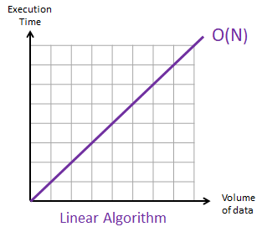
Time Analysis O(n)
Figure 3: Time Analysis

Slide 14
Space Analysis
By the experimental analysis, we found that in case of optimized approach, on increasing value of n (increasing the number of elements in array) the graph is constant. Thus the overall space remains same with an increase in no. of elements

Slide 15
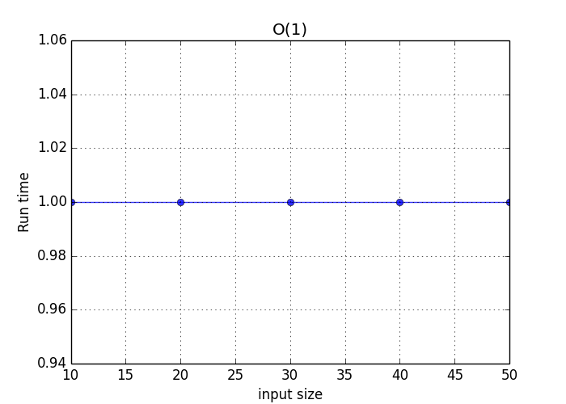
Space Analysis O(1)
Figure 4: Space Analysis

Slide 16
Conclusion
So, with the above mentioned algorithms and their profiling, we come to the conclusion that this problem of finding the length of substring which is having maximum differnece between number of zeroes and number of ones is achieving its best time complexity of O(n) and space complexity of O(1).

Slide 17
References
1. Introduction to Dynamic Programming and kadane’s Algorithm: https://www.geeksforgeeks.org/divide-andconquer-algorithm-introduction/
2. Introduction to Algorithms by Cormen,Charles, Rivest and Stein.
https://web.ist.utl.pt/ fabio.ferreira/material/asa

Slide 18
THANK YOU !!

